Slide 1
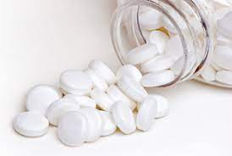
Lab.3 Industrial Pharmacy II
Tablet dosage form
Presented by
Assistant Lecturer: Aula Jawad

Slide 2
Introduction
Tablets are solid dosage forms usually prepared with the aid of suitable pharmaceutical excipients.
They may vary in
Size, shape, weight, hardness, thickness, disintegration, and dissolution characteristics
Tablets are classified according to
The Route of administration of tablets:
The most common one is (????)
And in other aspects; depending upon their intended use and method of manufacturing

Slide 3
Advantages
Patient acceptability due to:
( Portability, Hard to tamper with tablets, Easy to swallow, especially if coated.)
Relatively easy to manufacture ( cheap) and package
Provide accurate dosing ( Unit dosage form)
Increased stability of the drug when compared to liquid dosage forms.
Product identification is easy especially with use of imprints.
Can be coated or designed for delayed release.

Slide 4
disadvantages
Formulation difficulties, if the drug resists compression (amorphous nature, low-density).
Some drugs have poor wetting or poor water solubility or poor dissolution which might affect the drug’s bioavailability.
Q/Suggest an alternative dosage form??
Bitter taste drugs or drugs sensitive to oxygen or moisture might require encapsulation or coating.
Not suitable for liquid drugs.

Slide 5
Ideal properties of tablets
Elegant products have their own identity while free of defects such as chips, cracks, and discoloration.
• Should withstand the rigors mechanical shocks encountered in its production, packaging, shipping, and dispensing.
• Should be physically stable during their designed shelf life.
• Must be able to release the medicinal agent(s) in the body in a predictable and reproducible manner.
• Have a suitable chemical stability over time that do not allow alteration of the medicinal agent(s).

Slide 6
Tablet Excipients
Fillers or diluents (bulking agent)
To make a reasonably sized tablet
Improve cohesion, permit direct compression, promote flow.
It is essential that fillers be inert and stable.
A - Soluble : lactose , sucrose , mannitol , sorbitol .
B- Insoluble: calcium sulfate, dibasic calcium phosphate (low moisture), tricalcium phosphate, starch, calcium carbonate.
Filler must be:
Having good flowability and compressibility.
Inert, cheap, tasteless, able to disintegrate

Slide 7
Binders (adhesives):
To promote adhesion of particles of formulation and enable granulation also maintenance of integrity of the final tablet
Binders may be added as:
Dry powder in dry granulation
Solution in wet granulation
They are either sugars or polymeric materials
Examples
Water
Ethanol
- Acacia mucilage (10-20%)
- Gelatin solutions (2-10%)
-Starch mucilage (5-10 %)
PVP(3-15%)
Cellulose derivative (5-10 %).

Slide 8
Lubricants, glidants, and anti–adherents: they prevent the most common problem during tableting. (the flow of granulation, the adhesion of the material to the punches and dies, and the release of the tablet from the press.)
Lubricants: These are those agents that the friction between the tablet edge and die wall during the ejection cycle. e.g. magnesium stearate
Lubricants are usually added at the very last step before compression
Glidants :
Reducing friction between the particles
To improve the flow properties of the granulations (spherical)
e.g. talc, Silica derivatives
Anti–adherents: Function to prevent tablet granulation from sticking to the faces of the punches and the die walls e.g. talc, and starch.

Slide 9
Disintegrants :
To promote the breakup of the tablets into small particles
To promote rapid release of the drug and thus rapid availability
Method of adding disintegrant :
It is better to add it in two portions, one half is added to the powdered components before the wet granulation process and the remaining portion is added to the finished granulation just prior to the compression. This method holds that a disintegrant is required between the granules as well as within them
- Starch (5-20% w/w ) , Avicel (5-20 % w/w) , Alginic acid (5-10 %w/w) ,Bentonite ( 5-15 % w/w)
Preservatives
Flavouring agents
Film formers
Opacifiers and colours

Slide 10
Manufacturing method
Dry methods direct compression
dry granulation
Wet methods wet granulation
Regardless whether tablets are made by direct compression or granulation, the first step, milling and mixing, is the same; subsequent step differ.

Slide 11
Direct Compression
All the materials are blended together and sieved then compressed directly.
Properties of directly compressed materials
The API itself is compressible and/or it can be mixed with a filler that is compressible (e.g. lactose).
API should have good flow properties
It involves only two unit operations: 1. Powder mixing 2. Tabletting.

Slide 12
The advantages of the direct compression method
Low cost , time- consuming
Elimination of heat and moisture, thus increasing not only the stability but also the suitability of the process for thermolabile and moisture sensitive API’s.
fewer processing steps

Slide 13
Limitations of direct compression
There are only few crystalline substances that may compressed directly.
Most materials have low intermolecular attraction forces (cohesion) which minimize compression.
For small doses drugs, it is not practical to achieve a uniform blend from the API and the coarser diluent. Therefore, granulation is most suitable.
Differences in particle size lead to segregation.
The process is carried out in dry conditions, static charges may exist and result in mixing problems (flowability)

Slide 14
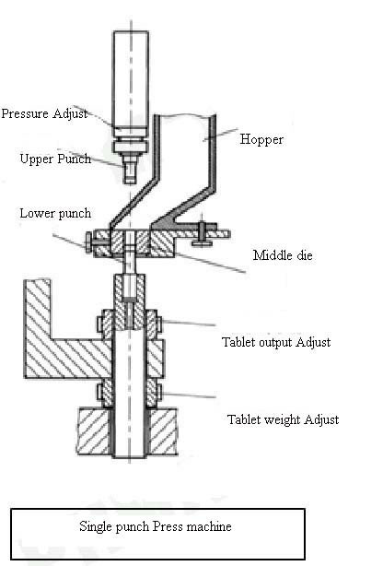
Single Punch Tablet Machines
Consists of hopper which delivers the powder blend into the die
The die which gives the size and shape of the tablet
The upper punch and lower punch are moving to fill the die and eject the tablet

Slide 15
Tablet compression machine
Hopper for holding and feeding granulation (or powder) to be compressed
Feed frame for distributing granulation from the hopper into the dies
Dies for controlling the size and shape of the tablet
Cam tracks for guiding the movement of the punches
Punches for compressing the granulation within the dies

Slide 16
Compression process
Filling
By gravitational flow of powder from hopper via the die table into die. The die is closed at its lower end by the lower punch.
Compression
The upper punch descends and enters the die and the powder is compressed until a tablet is formed.
During the compression phase, the lower punch can be stationary or can move upwards in the die.
After maximum applied force is reached, the upper punch leaves the powder i.e. the decompressed phase.
Ejection
During this phase, the lower punch rises until its tip reaches the level of the top of the die. The tablet is subsequently removed from the die and die table by a pushing device.

Slide 17
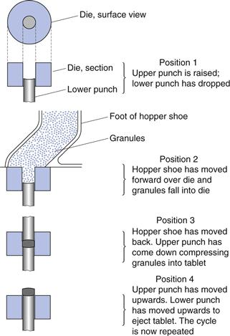

Slide 18
procedure
Metronidazole 200 mg 2.4 g
MCC 345mg 4.14 g
Mg. Stearate 1%
Prep. 12 tablets
Weigh the required amount of metronidazole, and MCC to prepare 12 tablets and mix them geometrically. Avoid grinding (why??).
Pass through 30 mesh size sieve. (Why?)
Add the required amount of lubricant and mix for not more than 5 minutes. (Mixing time is critical and should not exceed 5 min. (explain).
Compress directly with a tableting machine.

Slide 19
Homeworks
1. Types of lactose? Disadvantages?
2. Advantage of dibasic calcium phosphate as diluent?
3. Lubricants are usually added at the very last step before compression why?
4. Low-dose drugs are not suitable to be manufactured by direct compression.
5. Add the required amount of lubricant and mix for not more than 5 minutes. (explain).

